Slide 1
Nine Effective Distance / Hybrid Learning Strategies
Mike Roberts
Link to slides: https://rb.gy/czmxbu
Handout: https://rb.gy/rmm9f5

Slide 2
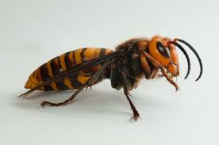

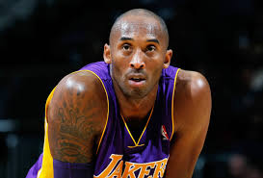
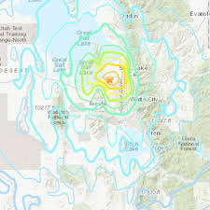
I mean...2020 right???
ews.okstate.edu
nhpr.org
cnbc.com
hearldextra.com

Slide 3
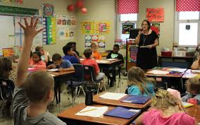
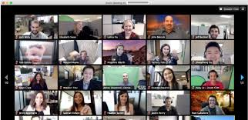
Teaching as we knew it has changed...
Our once crowded classrooms were instantly turned into a somewhat crowded Zoom screen, and our hands-on teaching turned virtual nearly overnight.

Slide 4
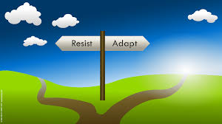
cvpcorp.com
And this left us with two options

Slide 5

For those who are trying to adapt, here are nine effective distance/hybrid learning strategies to help you be the best online teacher you can be!

Slide 6

Bring the mojo!
Make lemonade out of lemons by smiling a lot and using lots of inflection in your voice.
If you want your students to be into the learning, you have to model that first!
medium.com

Slide 7
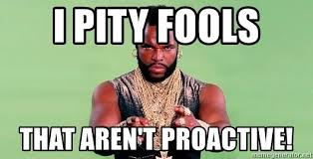
Be Proactive!
Do some practice drills to prepare for when (not if) things fail.
The more you prepare, the less impact tech issues will have.
memegenerator.com

Slide 8

Remember that you’re not in the classroom anymore
Going online isn’t as simple as just doing the same thing as you would have done in the classroom.
You need to be willing to adjust both your lessons and your teaching style to fit the needs of your students.
memgenerator.com

Slide 9

Let your students talk to one another
In the chat box...
In breakout rooms...
Within the whole class

Slide 10
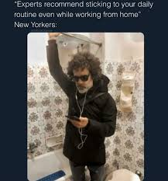

Create a daily routine
Discuss what class is going to be like at the beginning of each session and reinforce as many daily routines as possible.
Talk about where to find hw, where to input questions, and how to use the chat box (among other things).

Slide 11
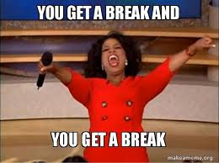
Break the learning into small chunks
While many of us already do this within our in-person classes, I challenge you to break it up into even smaller chunks when teaching online. The more you can keep things fresh, the less likely students will be to disengage from the learning.
The key is to “read the room” as you’re teaching. As soon as things start to fade, it’s time to move on to the next segment of the learning.
memegenerator.com

Slide 12
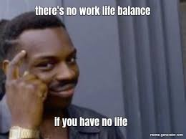
Balance Synchronous and Asynchronous Learning
Similar to in-person classes, using a variety of teaching approaches also applies to online classes. Plus, letting students work independently or in small groups will give you a few minutes to plan out your next phase of the lesson.
Breakout rooms should be a regular part of your online teaching. Think of them as an online “turn-and-talk”.
memegenerator.com

Slide 13

Try to follow up with missing students
When students don’t show up to our in-person classes, we reach out to find out why. The same should hold true with regard to students who miss their online classes.
Jump on this early! You don’t want to go three or four days before reaching out.
imgflip.com

Slide 14
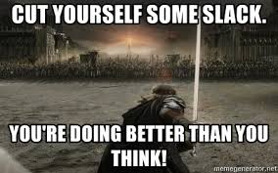
Cut yourself some slack
In case you haven’t heard, there is a pandemic going on right now. It’s ok if your best right now isn’t your best from other years.
I think most teachers are giving their students the benefit of the doubt. Don’t forget to give yourself that same grace.
memegenerator.com

Slide 15
Contact Information
Mike Roberts
Website:thebaldenglishteacher.com
Email: thebaldenglishteacher@gmail.com
Twitter: @baldroberts (Twitter)
Link to slides: https://rb.gy/czmxbu
Handout: https://rb.gy/rmm9f5

