Slide 1
Fifty Self-Care Strategies for Teachers
Mike Roberts
thebaldenglishteacher.com
@BaldRoberts (Twitter)
thebaldenglishteacher@gmail.com
Slides available at
https://bit.ly/34CcLta
Handout available at
https://bit.ly/35GKPnj

Slide 2
The strategies have been broken up into six categories
Exercise
Physical/Mental Health
Splurge
Cutting Back
Self-Improvement
Activites

Slide 3
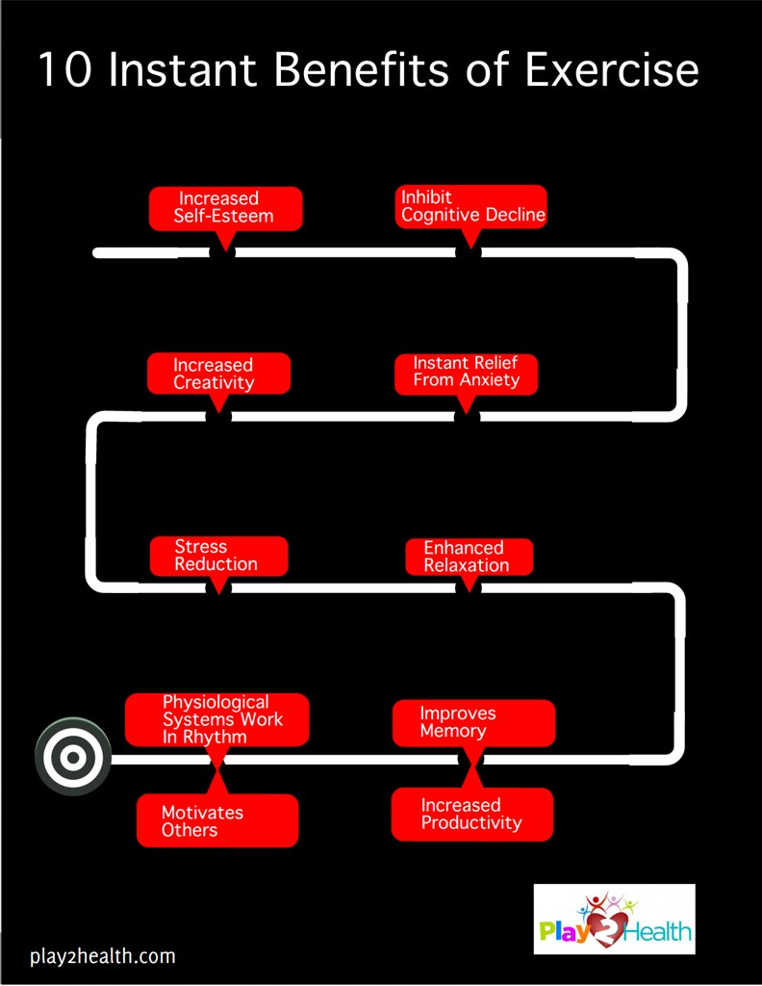
Exercise
Go for a nightly walk
Go for a run
Lift weights
Go for a hike
Do yoga
Do yard work
Go for a bike ride
Stretch
Shoot some hoops
"10 Instant Benefits of Exercise" by Play2Health.com is licensed under CC BY 2.0

Slide 4
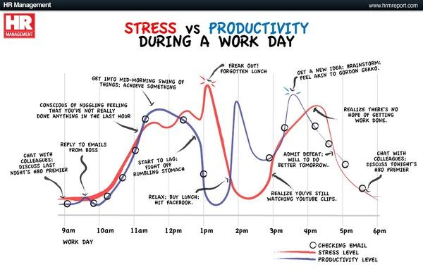
Physical/Mental Health
Go to bed at a decent hour
Meditate
Listen to a podcast
Take a hot bath/shower
Listen to your favorite songs
Do a crossword puzzle
Smile / laugh more in class
Send emails home
Journal
Stress vs Productivity" by GDS Infographics is
licensed under CC BY 2.0

Slide 5
Splurge
Go for ice cream
Stay in a hotel for a night
Go out to eat with friends
Get a massage
Order some takeout
Get a mani/pedi
"Chocolate Ice Cream Sundae" by TheCulinaryGeek is
licensed under CC BY 2.0

Slide 6
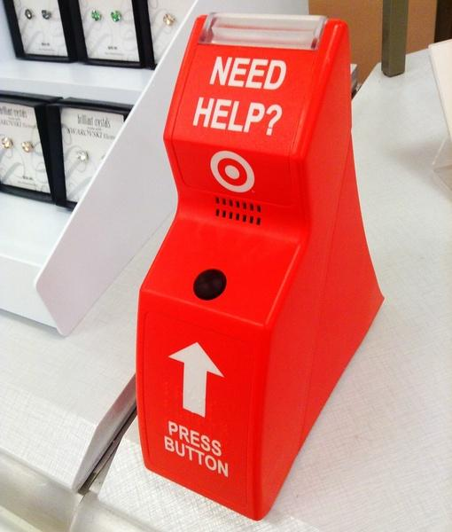
Cutting Back
Set aside some HW free days
Have email free nights
Learn to say no
Ask for help
Grade things as a class
Cut back on assignments
Let students self-assess
"Target Store Customer Help Button.” by JeepersMedia
is licensed under CC BY 2.0

Slide 7
Self-Improvement
Read a book
Watch a movie that fires you up
Reread student notes from
Watch an YouTube video
Listen to your breathing
Avoid negative people
Cut out screen time
Write down your goals
"iENFP.com Goal Setting To Live A Life Of Freedom 3" by
ienfp.com is licensed under CC BY 2.0

Slide 8
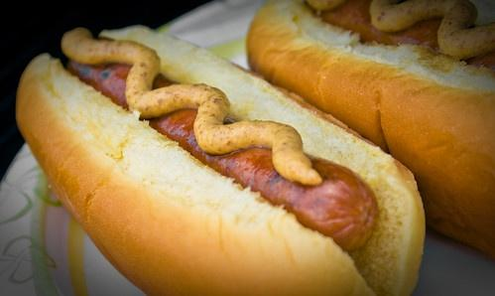
Activities
Go for a walk during lunch
Cook dinner
Play a video game
Draw
Knit
Play music
Play with your pets
Put together a puzzle
Visit a museum
Call your best friend
Go for a drive
"Hot Dogs on a Bun" by TheBusyBrain is licensed under CC BY 2.0

Slide 9
Fifty Self-Care Strategies for Teachers
Mike Roberts
thebaldenglishteacher.com
@BaldRoberts (Twitter)
thebaldenglishteacher@gmail.com
Slides available at
https://bit.ly/34CcLta
Handout available at
https://bit.ly/35GKPnj

